Slide 1
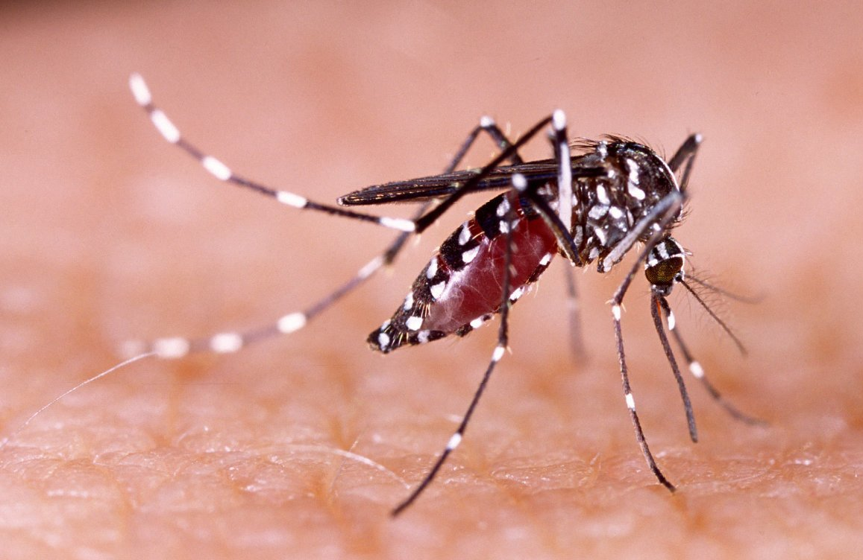
Temperature sensitivity of Dengue in Thailand
Project Proposal
Thaddeus Kühn, Dana Levi, Fiona Tanner, Frederik Racky
https://www.wissenschaft.de/wp-content/uploads/2/0/20-01-17-dengue.jpg

Slide 2
Overview
Background Data
Methods Milestones
Ideas Timeline

Slide 3
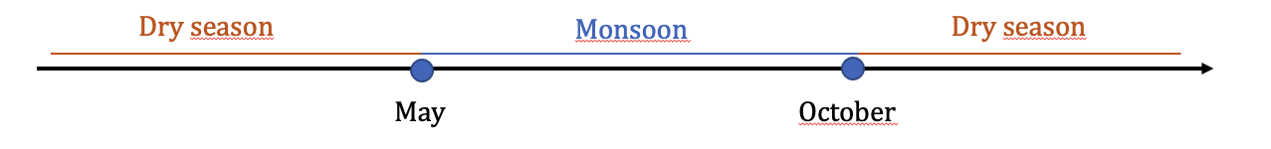
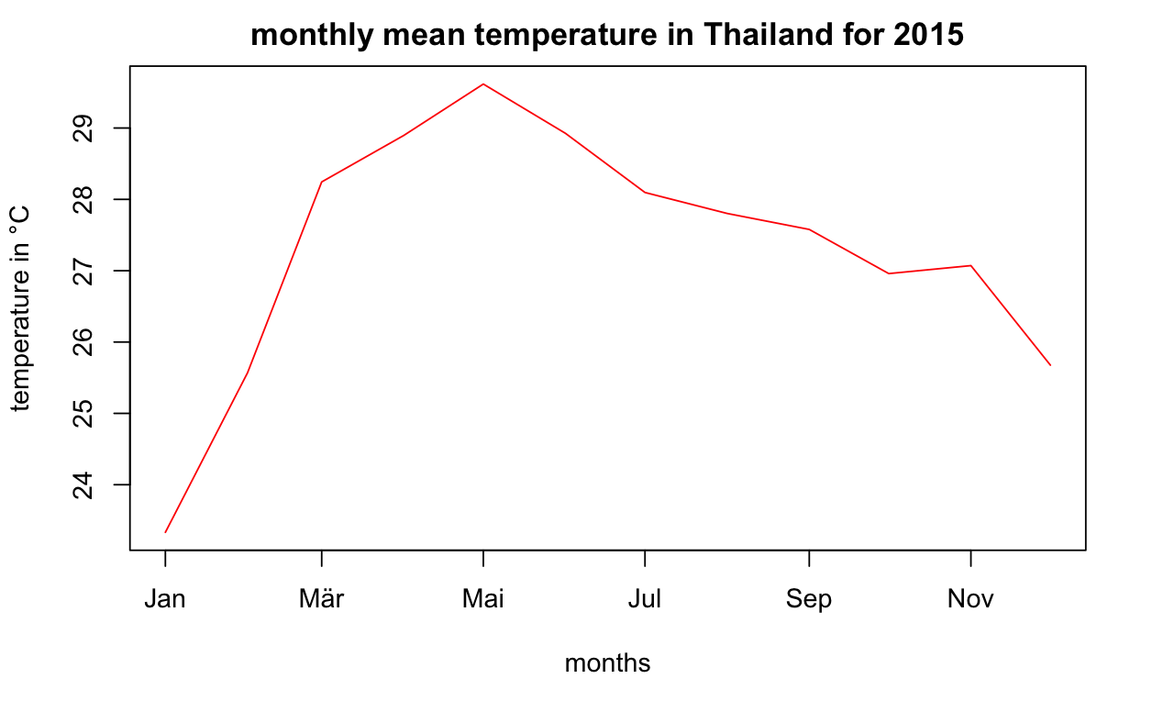
Climate
Notes:
Always warm in comparison to rest of world
Dry season: winter months are colder, march to may hottest months
Monsoon: may to oct, heavy rains, warm but decreasing temperature

Slide 4
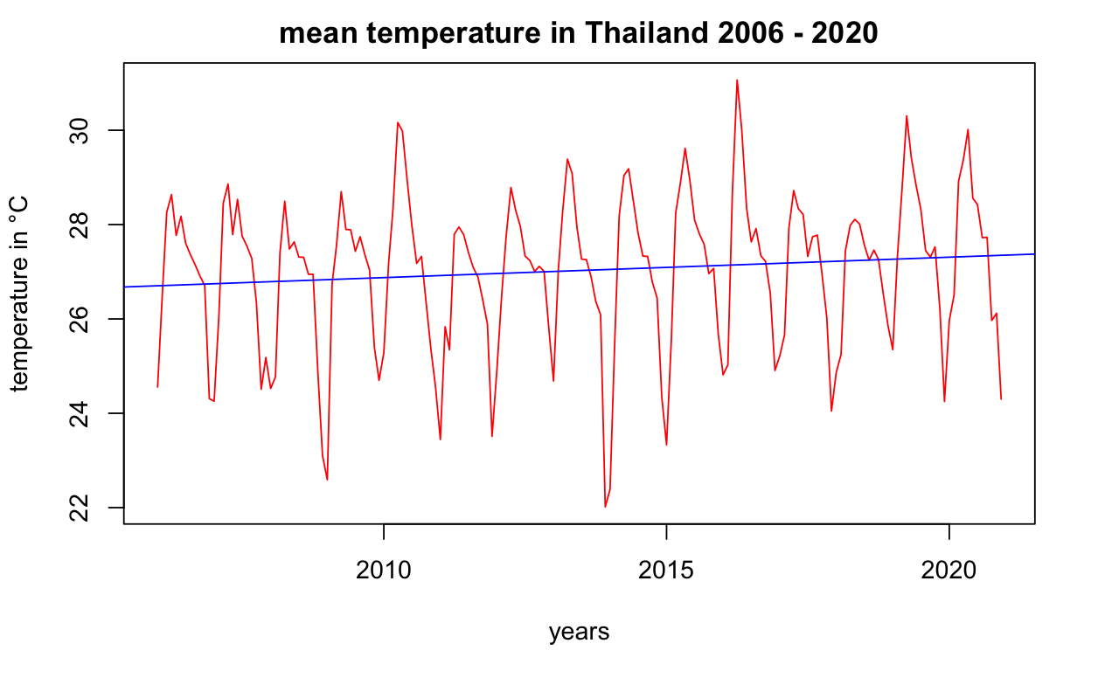
Climate
Notes:
Masud et al. Investigated climate in northern thailand -> Trends: rising min and max temperature in northern thailand, no significant rise in max in spring
We look at the whole country: slightr riding trend, check significance for distinct seasons
Minimum temperature in december 2013 -> thailand mean = 22 °C
Maximum temperature in april 2016 -> thailand mean = 31 °C
Every 5-6 years an extreme low/ high temperature is hit -> interesting to investigate if there is correlation to dengue data

Slide 5
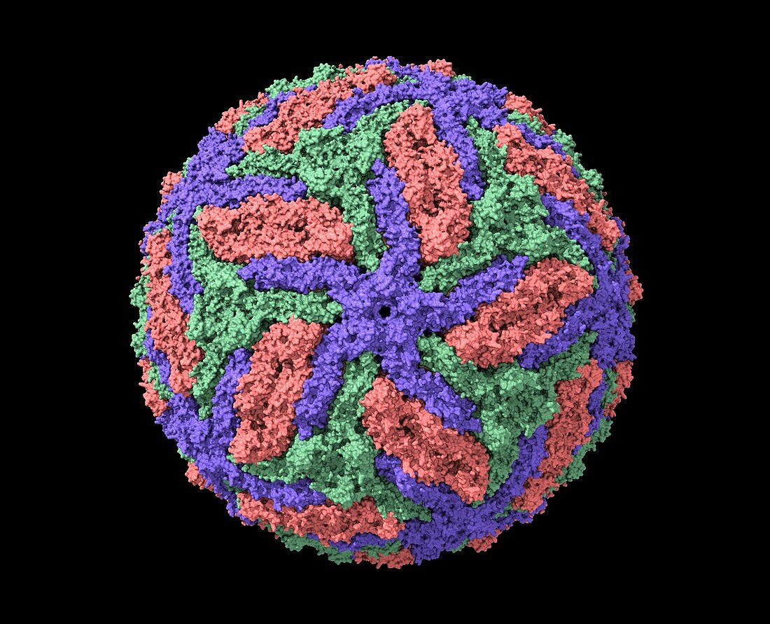
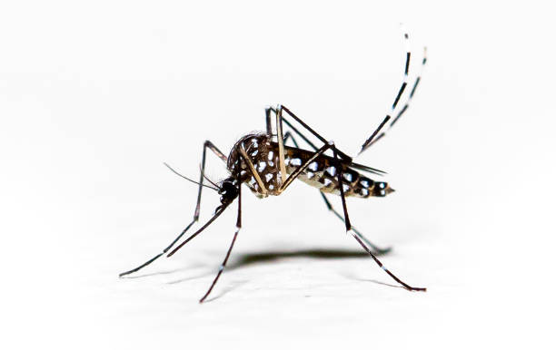

Dengue
https://media02.stockfood.com/largepreviews/NDE1NTg0NDgx/13405951-Dengue-virus-computer-model.jpg
https://media.istockphoto.com/id/1263464608/de/foto/aedes-aegypti-mosquito-pernilongo-mit-wei%C3%9Fen-flecken-und-wei%C3%9Fem-hintergrund.jpg?s=612x612&w=0&k=20&c=C3-vCzQG5kHMUMrfRKB1z1k5V7tmJkI6HpfEVtO6Hes=
Serotypes:
DENV 1-4
Aedes albopictus
Aedes aegypti
Notes:
Dengue fever is caused by dengue virus (four serotypes)
Vector borne -> transmitted by aedes mosquitoes, two types not distinguished in our study
Dengue hemmorhagic fever is characterized by fever, headache, bleeding/ bruising, joint/ muscle pain
WHO: 100 – 400 milllion infections worldwide / year (asia, africa, america)
No specific treatment -> major public health issue

Slide 6
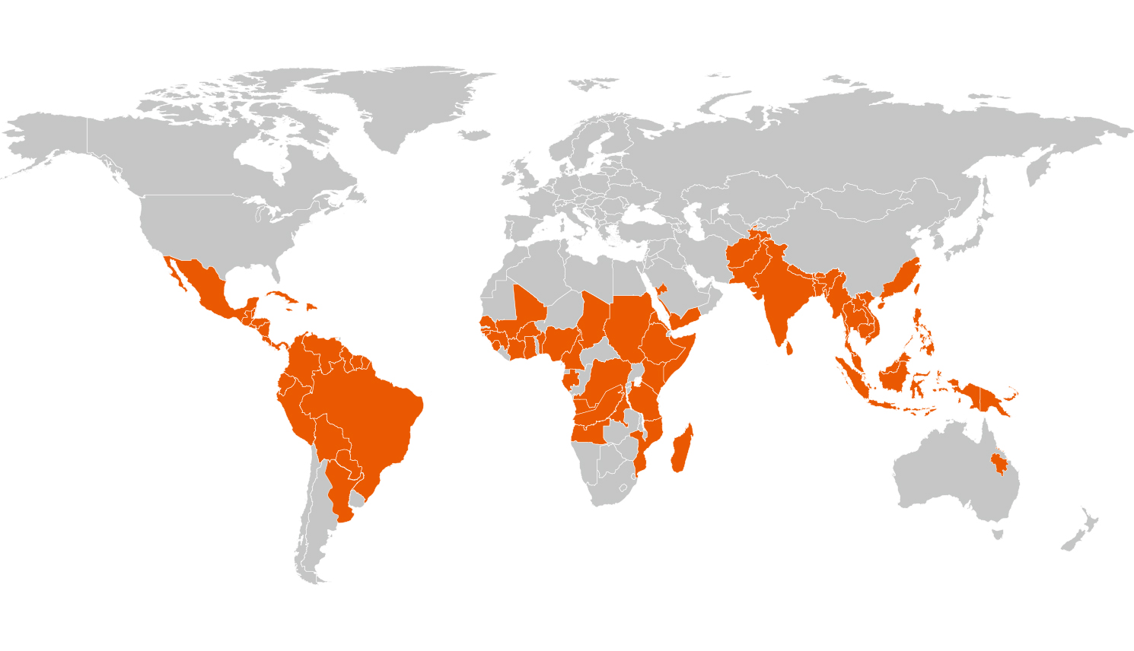

Dengue Virus
Viral infection caused by the dengue virus
Transmitted by the Aedes mosquitoes
Worldwide about 390 million infections per year
Major public health issue according to WHO
South-East Asia one of the most seriously affected areas
No specific treatment yet
Analysis and predicition are important strategies to prevent infections
https://www.euroimmunblog.de/dengue-diagnostizieren/

Slide 7
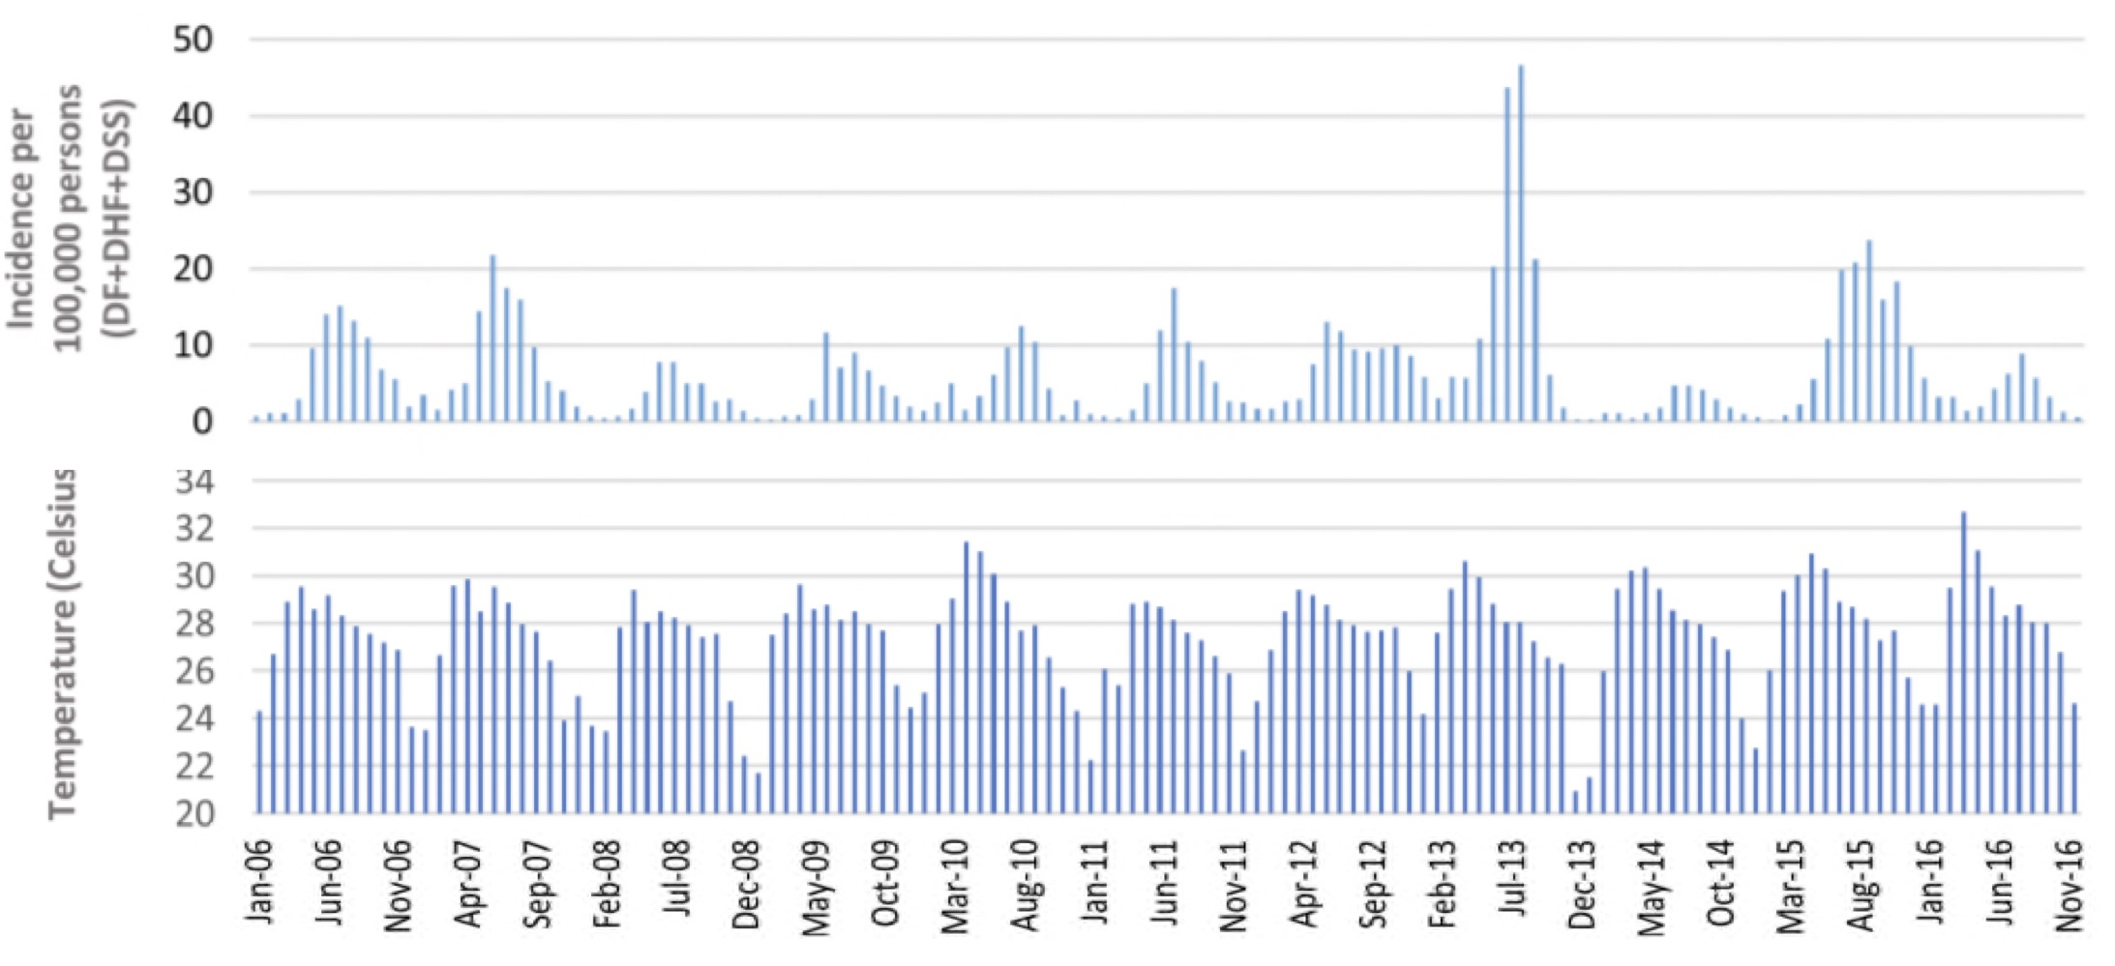
The relation between temperature and dengue
Climate variables are potential predictors of dengue transmission
Panichat et al:
maximum temperature positively associated with higher incidences
Most dengue cases occur at mean tempuratures beween 27 °C and 29.5 °C with a a maximum at 29°C
Development of Dengue cases and temperature in Thailand
https://www.ncbi.nlm.nih.gov/pmc/articles/PMC6708185/

Slide 8
Datasets
TEMPERATURE
ERA5 database
Monthly 2m temperature
2006 - 2022
DENGUE
DHF data
Total monthly infections per district 2006 - 2020
POPULATION
Data from 2012 – 2020
Estimates for 2006 – 2011 (linear regression model)
Notes:
ERA5 Data:
measurements, reanalysis of climate data since 1959 (hourly, 0,25°x 0,25° spatial resolution, 137 altitude levels (max. 80 km)
Extraction of monthly 2m temperature data from 2006 – 2022
Dengue data:
Dengue hemmorhagic fever
Monthly infections in every thailand province (77)

Slide 9
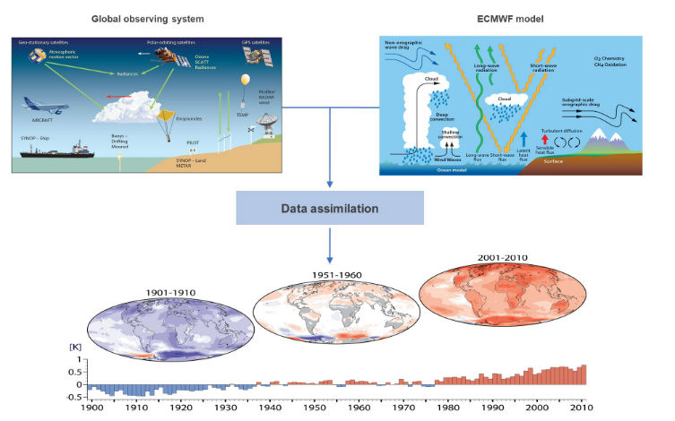
ERA 5 – Data set
ERA5 is the 5th generation global climate reanalysis by ECMWF and C3S
Covers January 1940 to present with hourly estimates of climate variables
Data on 30 km grid, including uncertainty information
Temperature is defined as air temperature at 2m above land, sea, or inland waters
Generated using advanced assimilation techniques and numerical models
https://www.ecmwf.int/en/about/media-centre/science-blog/2017/era5-new-reanalysis-weather-and-climate-data

Slide 10
Population data
 |  | 2012
Region | Province | Total | Male | Female
Whole Kingdom | Whole Kingdom | 64.266.365 | 31.614.938 | 32.651.427
Bangkok | Bangkok | 5.674.202 | 2.691.854 | 2.982.348
Central Region | Central Region | 16.141.516 | 7.868.275 | 8.273.241
 | Samut Prakan | 1.213.262 | 584.451 | 628.811
 | Nonthaburi | 1.132.150 | 531.490 | 600.660
 | Pathum Thani | 1.022.367 | 485.795 | 536.572
 | Phra Nakhon Si Ayutthaya | 790.581 | 381.626 | 408.955
 | Ang Thong | 283.972 | 136.278 | 147.694
 | Lop Buri | 757.093 | 380.213 | 376.880
 | Sing Buri | 213.402 | 101.838 | 111.564
 | Chai Nat | 333.214 | 160.827 | 172.387
 | Saraburi | 623.071 | 308.417 | 314.654
 | Chon Buri | 1.351.329 | 662.640 | 688.689
 | Rayong | 643.506 | 317.131 | 326.375
 | Chanthaburi | 519.333 | 255.603 | 263.730
http://statbbi.nso.go.th/staticreport/page/sector/en/01.aspx

Slide 11
Hypothesis
Do the dengue cases correlate with temperature?
Is this a linear correlation?
Are dengue cases per inhabitant higher in regions with higher population density?
Are there extreme climate events which influence dengue cases?
Are hotter month connected with more dengue cases?
Do hotter regions implicate more dengue cases?
Are years with higher temperature in accordance with years of high infection rates?

Slide 12
Further investigation ideas
How does temperature affect dengue mortality?
How do urbanized areas affect infection rates?

Slide 13
Data Analysis Methods
Data Integration
Cleaning Data
Data exploration
Data description
Data visualization
Dimension reduction
Statistical tests
Spatial analysis and mapping
Spatial-temporal analysis

Slide 14



Data integration

Slide 15

Cleaning Data
removing/Imputing missing values
removing low variance columns/rows
removing batch effects
correcting format of data
re-ordering rows/columns in meaningful and useful ways
https://www.flaticon.com/free-icon/data-cleaning_5140039

Slide 16
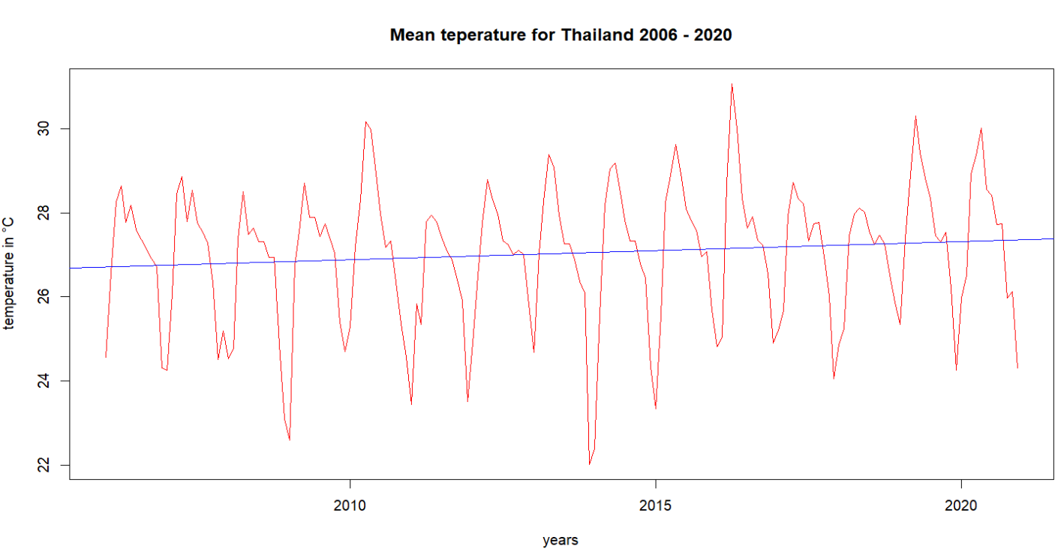
Exploratory data analysis
data description
examining the data types, dimensions and summary statistics
assessing distribution of variables (QQ-plot)
Identify associations and correlations (Pearson & Spearman)
data visualization
histogram, box plots, scatter plots
dimension reduction
k-means clustering
statistical test
t-test

Slide 17
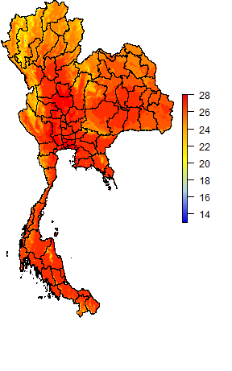
Spatial analysis and mapping
use of Geographic Information System (GIS) techniques to perform spatial analysis
identify clusters, spatial trends and relations between temperature and dengue outbreaks
visualize disease and temperature patterns
https://gadm.org/maps/THA.html

Slide 18
Sources
Masud, M. B., Soni, P., Shrestha, S., & Tripathi, N. K. (2016). Changes in climate extremes over North Thailand, 1960–2099. Downloads.Hindawi.Com, 1960–2099.
*dengue source*

Slide 19
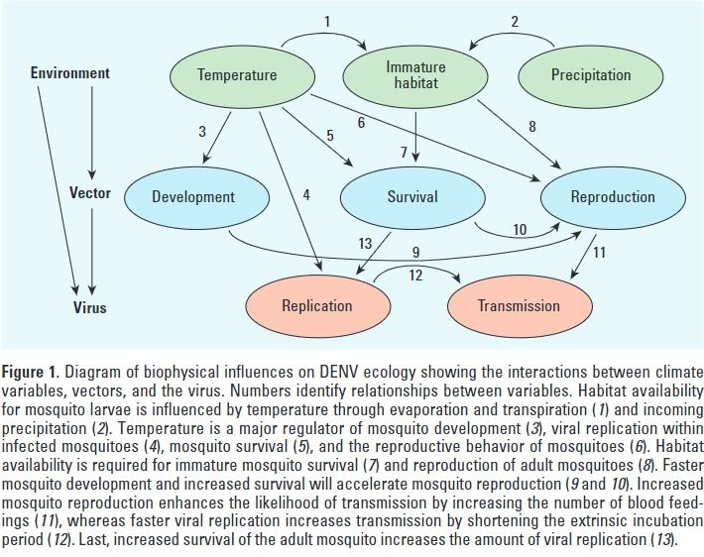
The effect of higher Temperatures on Aedes mosquitoes
Increased larval development
Higher rate of multiple feeding
Extrinsic incubation period declines
-> more infectious mosquitoes
Enhanced viral replication in the mosquitoes
higher transmission potential
Morin, C.W., Comrie, A.C., and Ernst, K. (2013). Climate and Dengue Transmission: Evidence and Implications. Environmental Health Perspectives 121, 1264-1272. 10.1289/ehp.1306556.

Slide 20
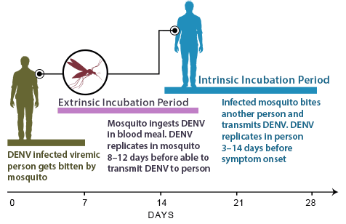
Intrinsic and extrinsic incubation period
https://www.cdc.gov/dengue/training/cme/ccm/page45915.html

Slide 21
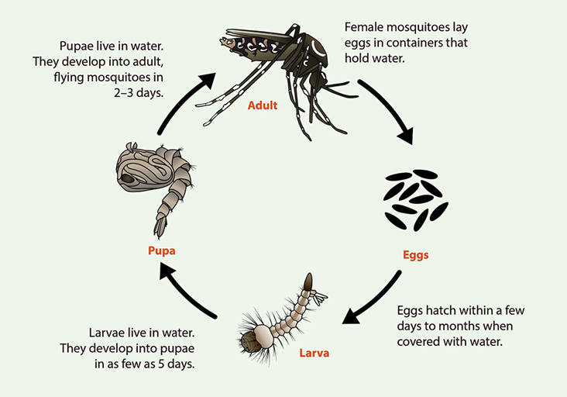
Replication cycle of the aedes mosquitoes
https://www.cdc.gov/mosquitoes/about/life-cycles/aedes.html

